Slide 1
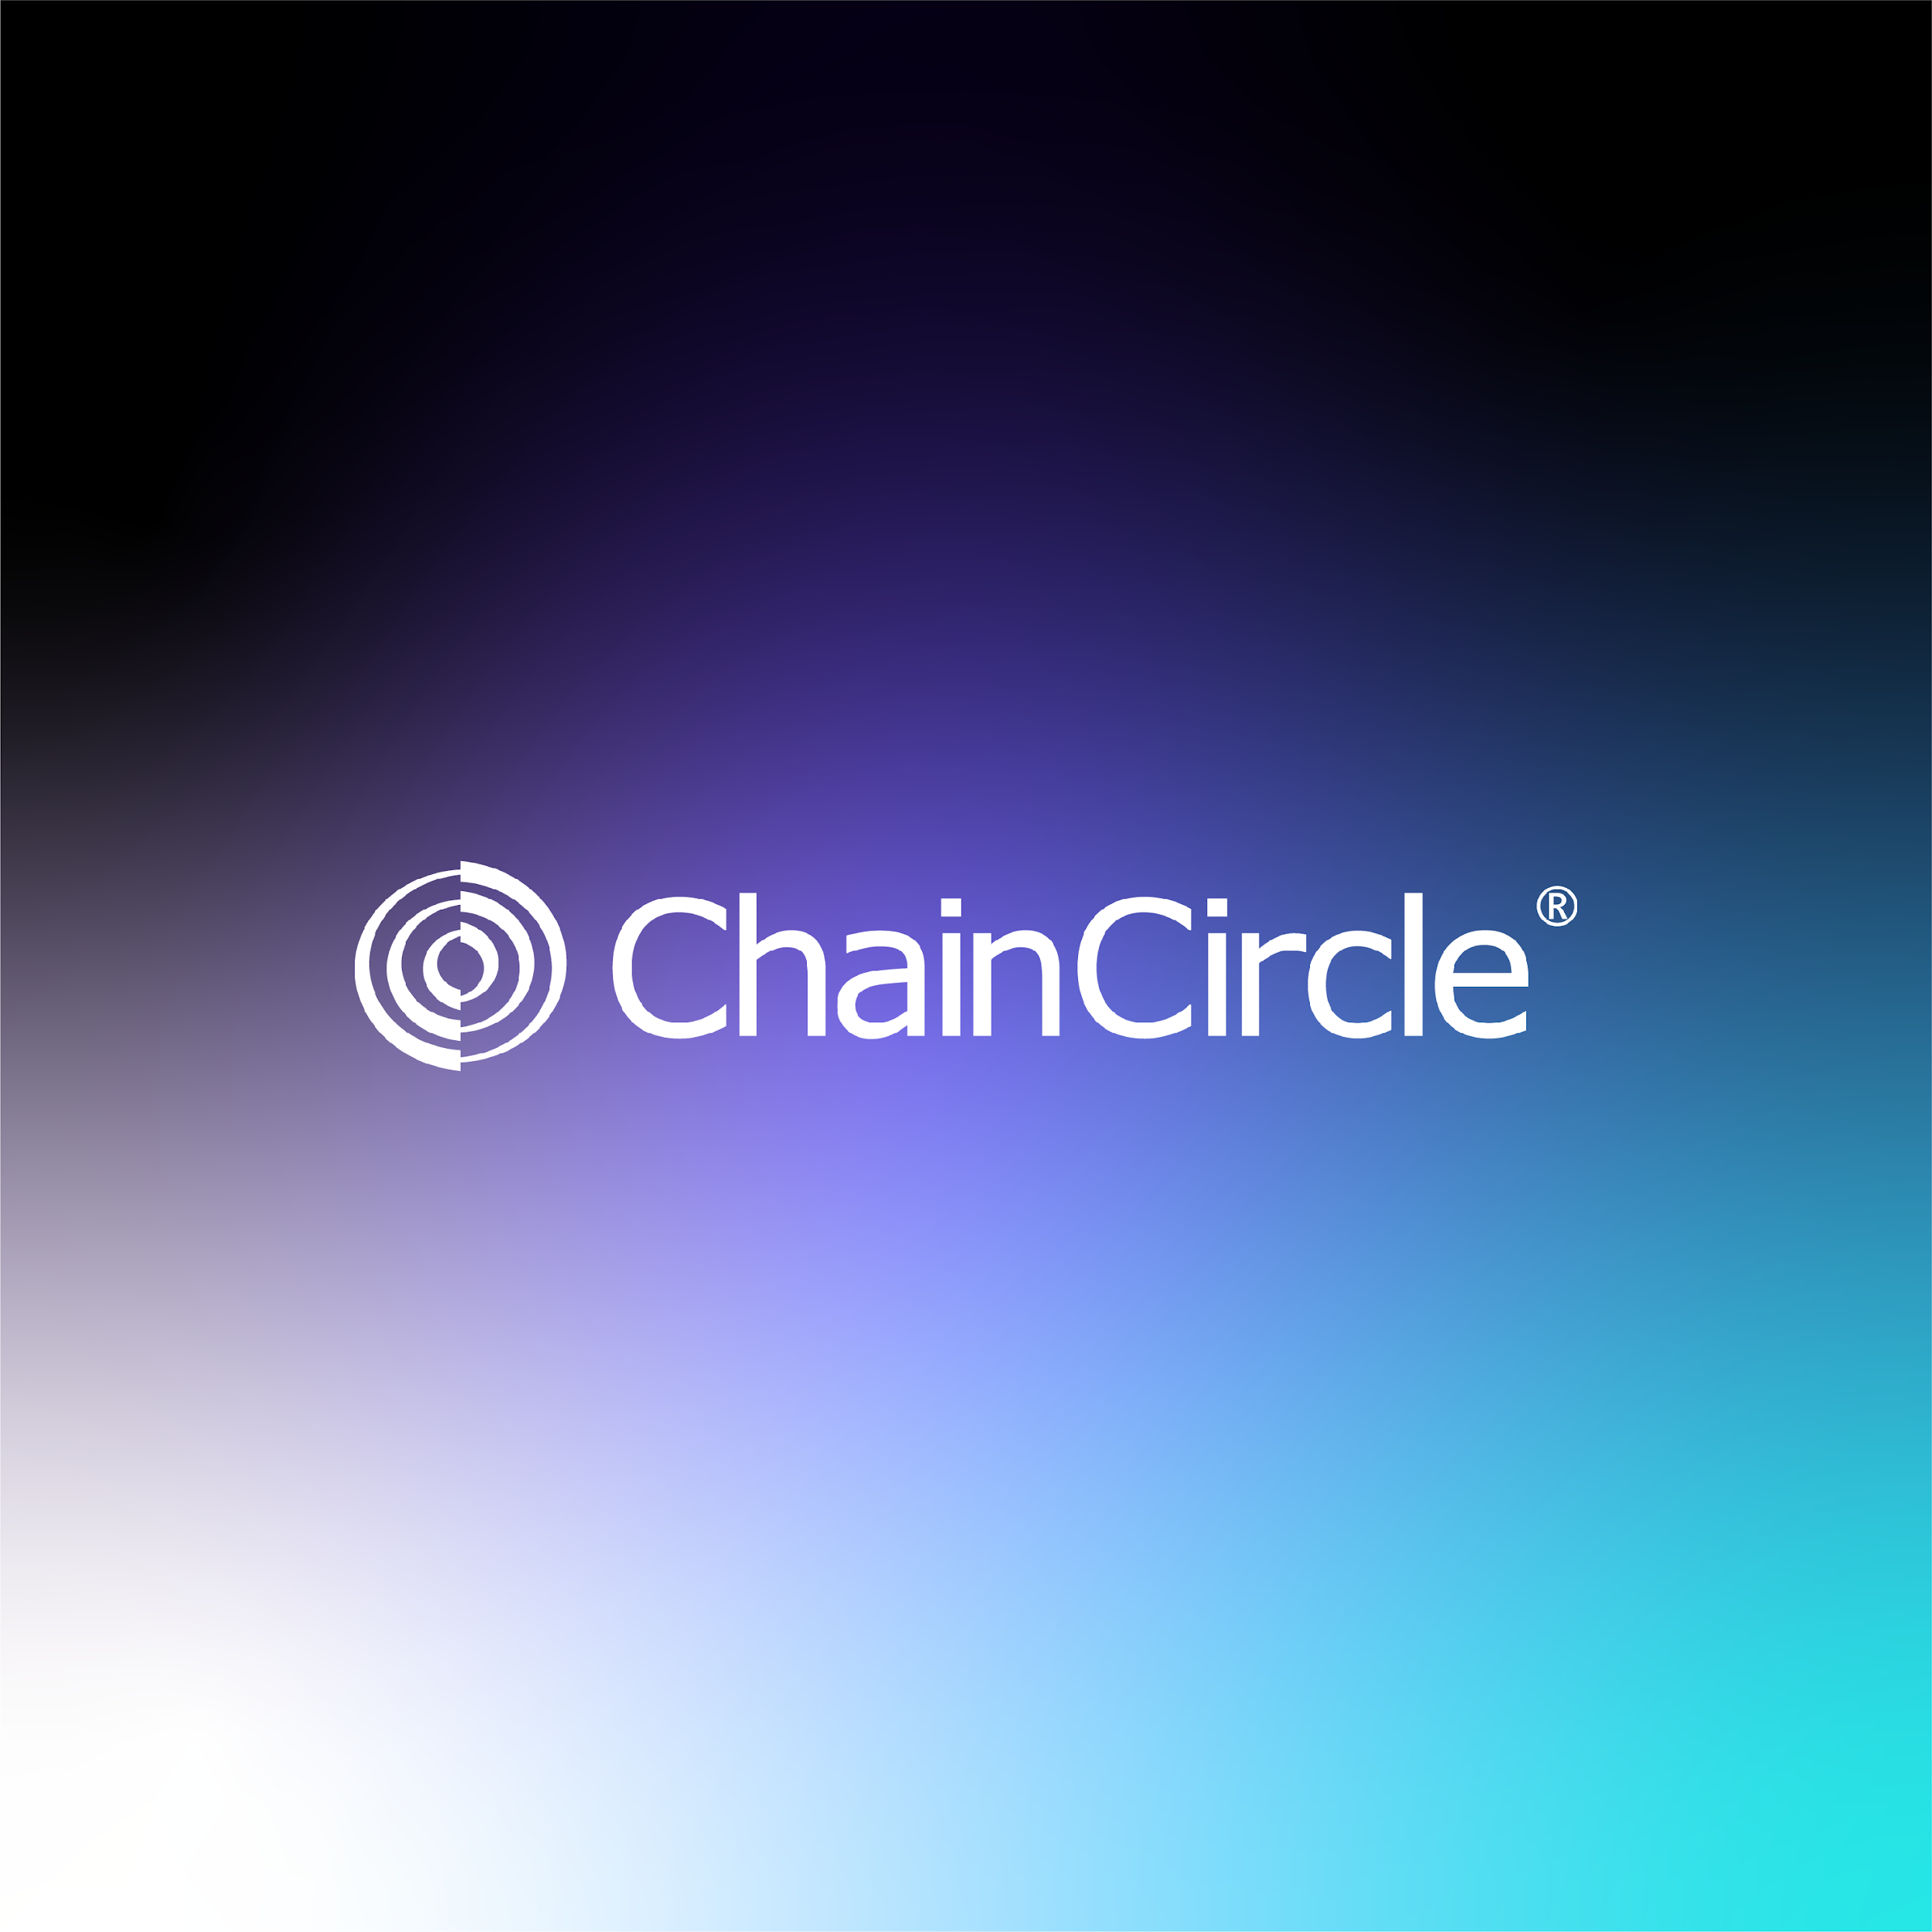

Slide 2


The Start - Q1 2025
SPL smart contract deployment on Solana Testnet
SPL smart contract deployment on Solana Mainnet
Team allocations and presale
Dapp launch with Token creation and Escrow features
Chaincircle Dapp and Bot Marketplace

Slide 3
Growth - Q2 2025
ChainCircle Dapp Marketplace
ChainCircle launchpad
DEX public security audit by third parties
Launching of DEX

Slide 4
The Future - Q4 2025/Q1 2026
CryptoCircle Network Phase 2.0
CrossChainTransaction network implementation
Launching of Dex
Education program for Aspiring blockchain devs
Launching on EVM chains.

Slide 5
Summary
ChainCircle is set to revolutionize the cryptocurrency exchange industry with its innovative and customer-focused platform, backed by an honest team and the latest in blockchain technology.
The Q1 2025 roadmap highlights the launch of the testnet, the deployment of the ChainCircle marketplace, and the introduction of CCX on the ChainCircle platform.
As we progress into Q3 2024, ChainCircle will continue to improve its offerings, with the launch of its decentralized exchange (DEX), the introduction of token staking and farming, and the release of the ChainCircle launchpad.
In the final phase of the roadmap, ChainCircle will focus on network expansion, with the implementation of the CrossChainTransaction network, the distribution of the network, and the release of CrossChainTransaction shares.
Get ready to experience the future of finance with ChainCircle, a platform that delivers on its promises and prioritizes the needs of its users.
Join us in this exciting journey towards a more efficient, secure, and accessible financial system.

Slide 6
THANK YOU
And welcome to ChainCircle!

